Slide 1

Recommended Host Traits for Listings123
An Investigation of Host Data for Company Expansion

Slide 2
Listings123’s Issue Answered by Analysis
The situation for Listings123 is that it needs to expand to new cities, and the marketing team needs to find ways to attract hosts with benefits and guides for success for new and existing hosts, which in turn should increase revenue. An overview of what constitutes a good host is necessary.
I cleaned, filtered, and compared thousands of rows of data to obtain visuals that permitted beneficial relationships between the qualities of hosts, that were not immediately apparent, to be obtained.
According to available data, I recommend Listings123 guides hosts to do the following:
Advise or encourage guests to leave reviews for them.
Attempt to keep their listings, at maximum, $300 in price.
Suggest hosts to list in locations or locations with similar qualities of other hosts with High (8-10) location review scores.

Slide 3
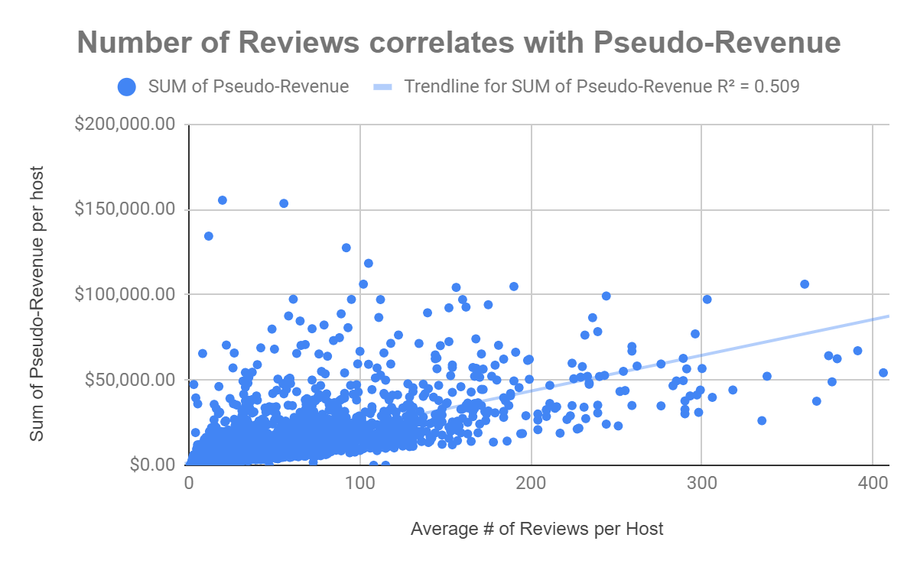
Hosts Should Advise Guests to Leave Reviews
The amount of reviews a host has Positively correlates with Revenue.
The host is minimizing vacancy of their listings, and has more guests.
If the host has more reviews with their listings and it correlates with revenue, it is beneficial for both the host and growth of the company’s revenue and market share.

Slide 4
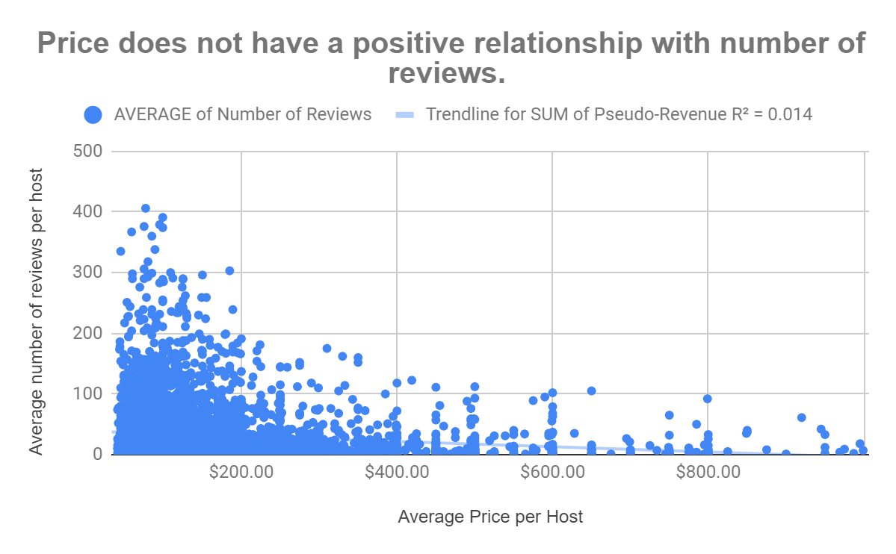
Hosts Should Try to Limit Prices to a maximum of $300
Notice the majority of the data, 94.7% of it, is present up to $300 in price
On average, guests are not booking and then reviewing listings above $300 in price.
Related to the prior recommendation, it is best to have more reviews for more revenue. Therefore, a maximum of $300 is advisable.

Slide 5
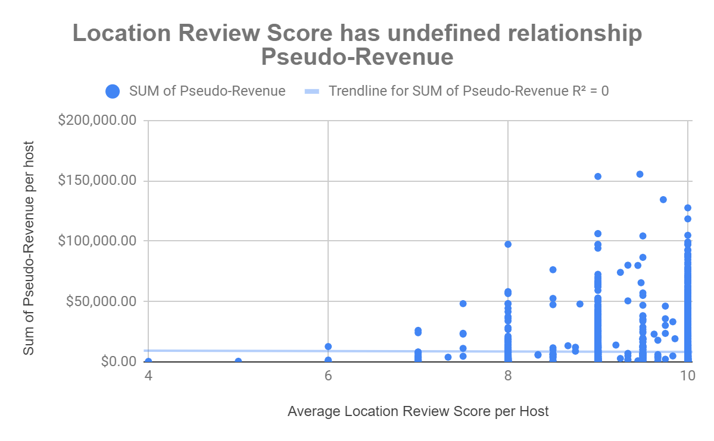
Hosts Should List in Areas Predicted to Have High Location Scores
The majority of the data, 99.4%, is has locations with high (8-10 out of 10) scores obtaining (99.6%) of all revenue
The locations and their qualities with a high score are hot spots for guests and increasing revenue
Hosts should list in the places with high scores to increase their bookings, revenue, and success as a host.

Slide 6
Next Steps
The next steps would be to create a guide for hosts, new and existing, to increase their personal success based on the recommendations in this presentation. Additionally, to increase the effectiveness of those recommendations we should:
Examine what makes a location worthy of high scores and which of its qualities can be found nationwide in other cities.
Develop a strategy to share with hosts to make guests feel more innately compelled to leave good reviews for a host and their listings.
Find cost cutting solutions for hosts to provide an exceptional experience while curbing running expenses to better meet the $300 maximum.
However, to complete these steps and accomplish outward growth for our small company, Listings123 will require a source of funds to launch a nationwide marketing expansion campaign for exposure allowing it to compete for hosts and guests against other services such as Airbnb in new and existing market territories.

